Slide 1

Predicting The Type & Location Of a New Venue
Caption
Piotr Zubrzycki 19-Jan-2021

Slide 2
PRESENTATION AGENDA
1
Introduction/Business Problem
2
Data Acquisition
3
Data Analysis
4
Conclusions

Slide 3

1. Introduction/Business
Problem

Slide 4
1.1 Background
Decision what type of place to open, and where it should be located, is crucial when preparing business plan for a new project. It is hard to keep track and understand which places have the biggest financial potential. Each year new or different businesses might be more popular than the others. Without proper analysis of the trends over the years, it is almost impossible to be sure that some particular type of venue is potentially more profitable than the others. It is also extremely important to know, where the new venue, which we would like to invest in, should be located. Because it is impossible to have an access to the financial records of each venue, it could be assumed that the number of visitors at some particular place (popularity) corresponds to the income. Also by utilisation of location data, the optimal area in reference to city centre could be chosen.
1.2 Problem
Data that might contribute to determine what business should be opened, in the particular city, based on number of citizens, might include number of visitors and its location in reference to the city centre and and other main areas such as train stations etc.. This project aims to predict what type of venue investor should invest in.
1.3 Interest
Everyone who thinks about investing into new venue, would be highly interested to see, what types of places are the most popular/profitable, and what is their ideal location.

Slide 5

2. Data Acquisition

Slide 6
2.1 Data sources
In different cities different venue types might be popular. This is why, in order to predict what is the best investment in the city of our interest, cities with simian size/population will be chosen for statistical analysis. Information about their population, is extracted from simplemaps.com (worldcities.csv). Because this file does not include data about size of the cities, it will be assumed that size correlates with population. Next the most popular venues will be selected based on their popularity. Such information can be extracted from foursquare.com. Additionally the optimal location will also be chosen based on the coordinates. This test will be run for several years in order to see what is the trend of the most popular venues.
2.2 Data examples
Selecting city we would like to invest in
city_name = “Krakow"
Finding cities with similar population. For our test we will find 20 cities from the same geographical region/country, in this case Poland, with the closest number of citizens to “city_name” (Krakow)
Depicting all cities on the map (city of interest (Krakow) marked on red):

Slide 7
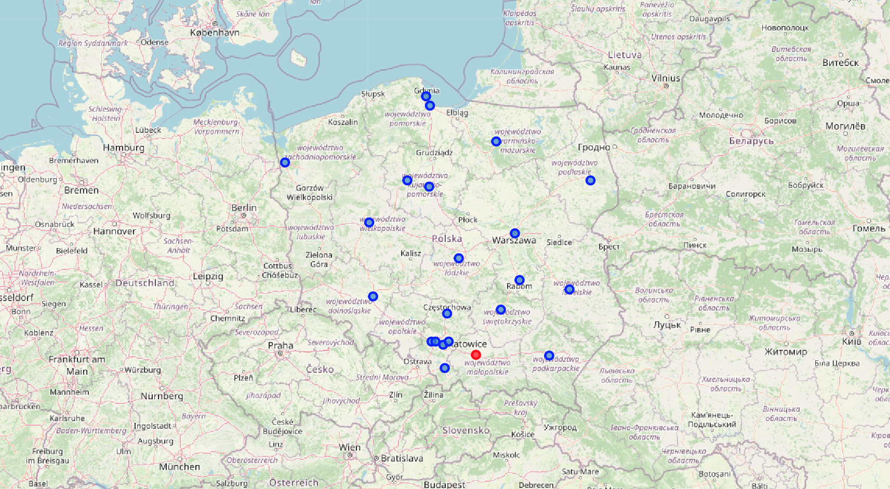

Slide 8

3. Data Analysis

Slide 9
3.1 Data Manipulation
Main issue with data extracted from foursquare.com (basic dev account) is that they do not consist of number of "check ins" into particular venue (I can't see such information in json file). It significantly limits whole analysis. Because we do not have this data, it will be assumed, that most viable option from the business perspective, will correlate with the venue which statistically occurs the most in analysed cities.
Checking what are statistically the most popular venues, in all analysed cities, for each ‘Date’. This way we can see, how trend changes over time
Below table shows to 10 venues for each date
Date | 1st Most Common Venue | 2nd Most Common Venue | 3rd Most Common Venue | 4th Most Common Venue | 5th Most Common Venue | 6th Most Common Venue | 7th Most Common Venue | 8th Most Common Venue | 9th Most Common Venue | 10th Most Common Venue
20130731 | Café | Hotel | Park | Fast Food Restaurant | Restaurant | Pizza Place | Coffee Shop | Shopping Mall | Italian Restaurant | Plaza
20131031 | Café | Hotel | Park | Fast Food Restaurant | Restaurant | Pizza Place | Coffee Shop | Shopping Mall | Italian Restaurant | Plaza
20140731 | Café | Hotel | Park | Fast Food Restaurant | Restaurant | Pizza Place | Coffee Shop | Shopping Mall | Italian Restaurant | Plaza
20141031 | Café | Hotel | Park | Fast Food Restaurant | Restaurant | Pizza Place | Coffee Shop | Shopping Mall | Italian Restaurant | Plaza
20150731 | Café | Hotel | Park | Fast Food Restaurant | Restaurant | Pizza Place | Coffee Shop | Shopping Mall | Italian Restaurant | Plaza
20151031 | Café | Hotel | Park | Fast Food Restaurant | Restaurant | Pizza Place | Coffee Shop | Shopping Mall | Italian Restaurant | Plaza
20160731 | Café | Hotel | Park | Fast Food Restaurant | Restaurant | Pizza Place | Coffee Shop | Shopping Mall | Italian Restaurant | Plaza
20161031 | Café | Hotel | Park | Fast Food Restaurant | Restaurant | Pizza Place | Coffee Shop | Shopping Mall | Italian Restaurant | Plaza
20170731 | Café | Hotel | Park | Fast Food Restaurant | Restaurant | Pizza Place | Coffee Shop | Shopping Mall | Italian Restaurant | Plaza
20171031 | Café | Hotel | Park | Fast Food Restaurant | Restaurant | Pizza Place | Coffee Shop | Shopping Mall | Italian Restaurant | Plaza
20180731 | Café | Hotel | Park | Fast Food Restaurant | Restaurant | Pizza Place | Coffee Shop | Shopping Mall | Italian Restaurant | Plaza
20181031 | Café | Hotel | Park | Fast Food Restaurant | Restaurant | Pizza Place | Coffee Shop | Shopping Mall | Italian Restaurant | Plaza
20190731 | Café | Hotel | Park | Fast Food Restaurant | Restaurant | Pizza Place | Coffee Shop | Shopping Mall | Italian Restaurant | Plaza
20191031 | Café | Hotel | Park | Fast Food Restaurant | Restaurant | Pizza Place | Coffee Shop | Shopping Mall | Italian Restaurant | Plaza

Slide 10
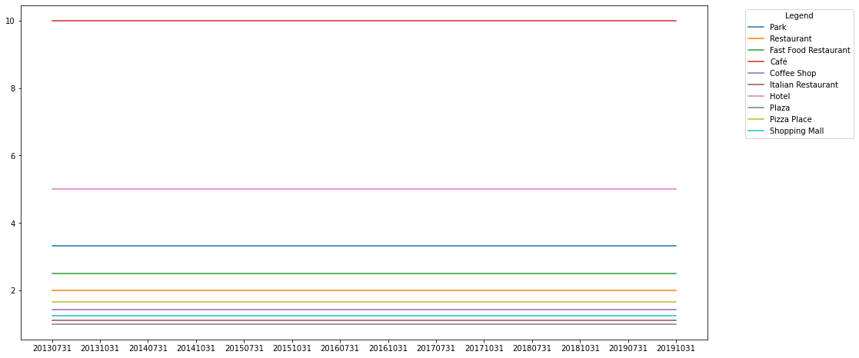
From table depicted on the previous slide, we can see that for each date there are exactly the same top 10 venues. That can indicate that foursquare.com database does not consist of data for each time period but just the latest one.
To plot data easier, numbers from 1 to 10 were assigned to the venues from above table, based on its popularity:
From above graph it can be noticed that the most popular venue is of type "Cafe" Based on above data it looks like there is no change in "popularity" over time among Venue Types. Looks like "forsquare" database does not consist of the data from various periods of time for analysed region.

Slide 11
3.2 Finding the best location for the "most popular" Venue
Now when we know what is the most popular Venue let’s find its average distance form the city centre.
Table below contains few examples of the city centre and cafe coordinates:
Venue Category | City Latitude | City Longitude | Venue Latitude | Venue Longitude
Café | 52.2167 | 21.0333 | 52.225629 | 21.019006
Café | 52.2167 | 21.0333 | 52.236939 | 21.024575
Café | 52.2167 | 21.0333 | 52.233204 | 21.010875
Café | 52.2167 | 21.0333 | 52.239527 | 21.022618
Café | 52.2167 | 21.0333 | 52.222851 | 20.988527
In order to calculate the distance between city centre and "Venue Category" (Cafe) the "Haversine" formula will be used. Next based on all distances median and mean values can be calculated:
Median of the distance: 1434.04
Mean of the distance: 1618.35
Printing the area of interest over the city of interest (Krakow)

Slide 12
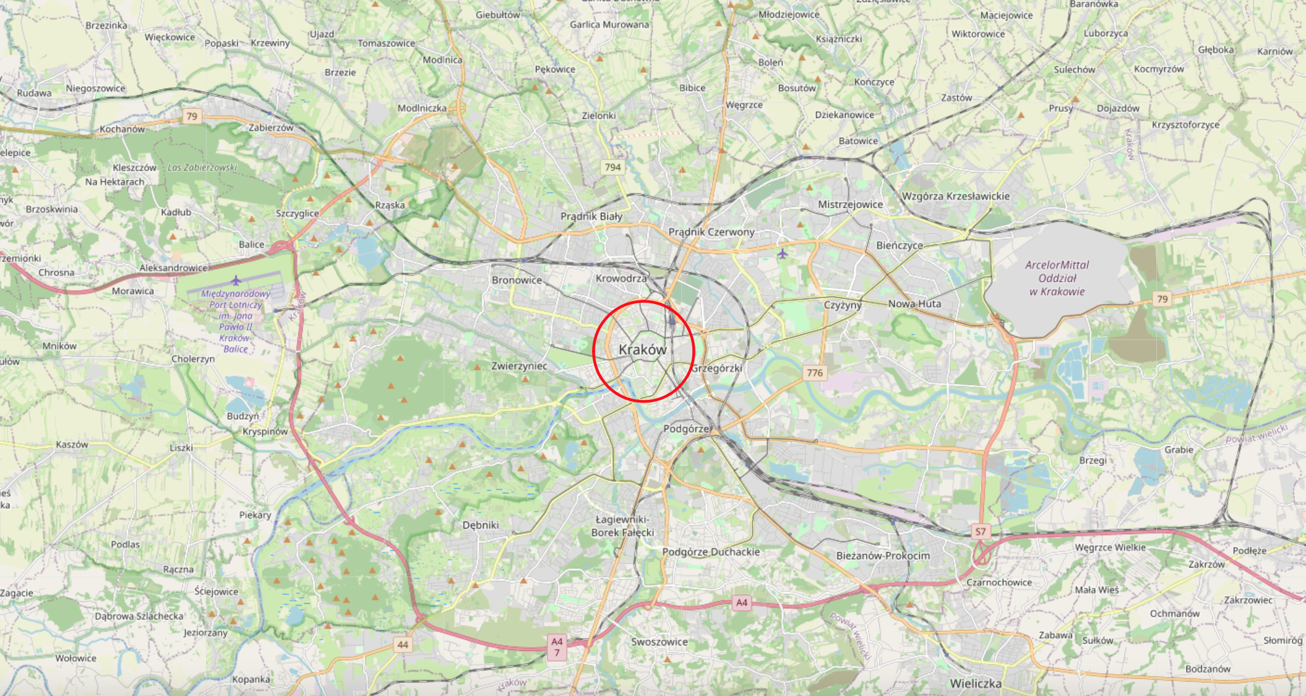

Slide 13

3. Conclusions

Slide 14
Based on the above analysis, it can be concluded, that the venue which we should invest in, is of type “Cafe". Its ideal location should be close to the city center.
Please note that due to limited number od data included in foursquare database for the analysed cities, it wasn’t viable to check the trend in popularity over time, of different venues. Thus no regression was used in order to predict the best investment for the future!!!.

